Slide 1
COMP 3500 Introduction to Operating Systems Project 3: Locks and Condition Variables

Slide 2
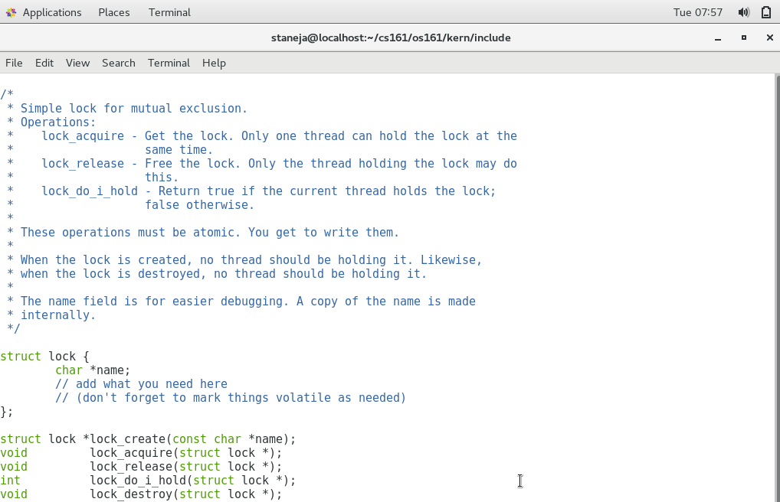
Exercise 1. How to modify the following Lock struct in OS/161? Can you complete the following lock function prototypes?
/* kern/include/synch.h */
struct lock {
char *name;
/* add what you need here. How? */
};
struct lock *lock_create (const char *name);
void lock_acquire (struct lock *);
void lock_release (struct lock *);
int lock_do_i_hold(struct lock *);
void lock_destroy (struct lock *);
struct thread *volatile holder;
Notes:
struct lock {
char *name;
// add what you need here
// (don't forget to mark things volatile as needed)
};
Optimization comparison in C[edit]
The following C programs, and accompanying assemblies, demonstrate how the volatile keyword affects the compiler's output. The compiler in this case was GCC.
While observing the assembly code, it is clearly visible that the code generated with volatile objects is more verbose, making it longer so the nature of volatileobjects can be fulfilled. The volatile keyword prevents the compiler from performing optimization on code involving volatile objects, thus ensuring that each volatile variable assignment and read has a corresponding memory access. Without the volatile keyword, the compiler knows a variable does not need to be reread from memory at each use, because there should not be any writes to its memory location from any other thread or process.

Slide 3
Lock: Sample Usage
/* Declare a lock */
static struct lock *sample_mutex;
/* Initialize the lock */
sample_mutex = lock_create(”sample mutex");
if (sample_mutex == NULL)
panic(”sample_mutex: Out of memory.\n");
/* Destroy the lock in the end */
lock_destroy(sample_mutex);
sample_mutex = NULL;
lock_acquire(sample_mutex); /* Acquire */
lock_release(sample_mutex); /* Release */
Notes:
In computer programming, a static variable is a variable that has been allocated statically so that its lifetime or "extent" extends across the entire run of the program. This is in contrast to the more ephemeral automatic variables (local variables are generally automatic), whose storage is allocated and deallocated on the call stack; and in contrast to objects whose storage is dynamically allocated in heap memory. Static memory allocation in general is the allocation of memory at compile time before the associated program is executed, unlike dynamic memory allocation or automatic memory allocation where memory is allocated as required at run time.
#include <stdio.h> void foo() {
int a = 10;
static int sa = 10;
a += 5;
sa += 5;
printf("a = %d, sa = %d\n", a, sa);
}
int main() {
int i;
for (i = 0; i < 10; ++i)
foo();
}
This prints:
a = 15, sa = 15
a = 15, sa = 20
a = 15, sa = 25
a = 15, sa = 30
a = 15, sa = 35
a = 15, sa = 40
a = 15, sa = 45
a = 15, sa = 50
a = 15, sa = 55
a = 15, sa = 60

Slide 4
Exercise 2. Please complete the following lock_acquire()
void lock_acquire(struct lock *lock) {
turn off interrupts; /*see P(*sem) in next slide*/
if (lock_do_i_hold(lock)) /* check deadlock */
panic("lock %s at %p: Deadlock.\n",
lock->name, lock);
/* wait the lock to become free */
while (lock’s holder != NULL) {
sleep this thread; /*see P(*sem) in next slide*/
}
/* woken up now- this thread is holding the lock */
lock’s holder is set to curthread;
turn on interrupts to the previous level;
}

Slide 5
How to sleep the current thread?
void P(struct semaphore *sem) {
int spl;
assert(sem != NULL);
spl = splhigh();
while (sem->count==0) {
thread_sleep(sem);
}
assert(sem->count>0);
sem->count--;
splx(spl);
}
Check input argument
Turn off interrupts
‘sem’ is a flag or indicator
Turn on interrupts
Notes:
Assertion statements are used to test assumptions made by the programmer

Slide 6
How to wakeup a thread?
void V(struct semaphore *sem)
{
int spl;
assert(sem != NULL);
spl = splhigh();
sem->count++;
assert(sem->count>0);
thread_wakeup(sem);
splx(spl);
}
Check input argument
Turn off interrupts
‘sem’ is a flag or indicator
Turn on interrupts
Notes:
Assertions are statements used to test assumptions made by programmer

Slide 7
Exercise 3. Please complete the lock_do_i_hold() function.
int lock_do_i_hold(struct lock *lock) {
int spl, same;
use assert() to input argument lock;
Turn off interrupts;
if (lock->holder is the same as this thread)
set same to 1; /* true */
else set same to 0; /* false */
Turn on interrupts to previous level;
/* 1 means lock is held by this thread */
return same;
}
Is lock held by this thread?
Notes:
lock != NULL
This thread = curthread

Slide 8
Condition Variables
Notes:
Cont. from Lec05c-Project 3 Cats and Mice Implementation
50 Min: 12 slides

Slide 9
Condition Variables: Data Structure
Wait until a variable meets a particular condition
There is no actual variable in the CV
/* kern/include/synch.h */
struct cv {
char *name;
// add what you need here
};
Notes:
There is little information on condition variables in the textbook

Slide 10
Condition Variables: Functions
/* Release lock, put thread to sleep until cv is signaled; when thread wakes up again, re-acquire lock before returning */
void cv_wait(struct cv *c, struct lock *mutex);
/* If any threads are waiting on cv, wake up one of them. Caller must hold lock, which must be the same as the lock used in the wait call */
void cv_signal(struct cv *c, struct lock *mutex);
Notes:
References: http://web.stanford.edu/class/cs140/cgi-bin/lecture.php?topic=locks
Operations:
cv_wait - Release the supplied lock, go to sleep, and, after
waking up again, re-acquire the lock.
cv_signal - Wake up one thread that's sleeping on this CV.
cv_broadcast - Wake up all threads sleeping on this CV.

Slide 11
Condition Variables: Functions (cont.)
struct cv *cv_create(const char *name);
void cv_destroy(struct cv *);
/* Same as signal, except wake up all waiting threads */
void cv_broadcast(struct cv *cv,
struct lock *lock);
Notes:
References: http://web.stanford.edu/class/cs140/cgi-bin/lecture.php?topic=locks
Operations:
cv_wait - Release the supplied lock, go to sleep, and, after
waking up again, re-acquire the lock.
cv_signal - Wake up one thread that's sleeping on this CV.
cv_broadcast - Wake up all threads sleeping on this CV.

Slide 12
Producer/Consumer Implementation with Locks
char buffer[SIZE];
int count = 0, head = 0, tail = 0;
static struct lock *mutex;
mutex = lock_create(“mutex for cv”);
void producer(char c) {
lock_acquire(mutex);
count++;
buffer[head] = c;
head++;
if (head == SIZE) {
head = 0;
}
lock_release(mutex);
}
char consumer() {
char c;
lock_acquire(mutex);
count--;
c = buffer[tail];
tail++;
if (tail == SIZE) {
tail = 0;
}
lock_release(mutex);
return c;
}
Notes:
Let’s consider the producer/consumer sample to show how to use condition variables
We start this example with locks.
3. No need to use static here; just a demonstration

Slide 13
Exercise 4. Can you explain this code? How to handle the empty/full cases using locks?
void producer(char c){
lock_acquire(mutex);
while (count == SIZE)
{
lock_release(mutex);
lock_acquire(mutex);
}
count++;
buffer[head] = c;
head++;
if (head == SIZE)
{
head = 0;
}
lock_release(mutex);
}
char consumer() {
char c;
lock_acquire(mutex);
while (count == 0) {
lock_release(mutex);
lock_acquire(mutex);
}
count--;
c = buffer[tail];
tail++;
if (tail == SIZE) {
tail = 0;
}
lock_release(mutex);
return c; }
Which lock_acquire() and lock_release() are a pair?
Can we improve this code using wait and signal?
Notes:
Which lock_acqure and lock_release are a pair? No active check => why we need CV => fall into sleep
When count == size cond is true, then outer lock_acquire() and lock_release() inside the while is becomes a pair. If the condition remains false (i.e., the list isn’t full), then outer lock_acquire() is a pair with outer lock_release. When consumer releases the lock, lock_acquire(mutex) inside the while loop may acquire the mutex. In that case, this inner lock_acquire() forms a pair with outer lock_release()
Note that we are busy waiting on the while loop => wasting CPU cycles.

Slide 14
Producer: how to use condition variables in OS/161?
void producer(char c) {
lock_acquire(mutex);
while (count == SIZE) {
cv_wait(notFull, mutex);
}
count++;
buffer[head] = c;
head++;
if (head == SIZE) {
head = 0;
}
cv_signal(notEmpty, mutex);
lock_release(mutex);
}
Notes:
Never ending sleep =inceptoim

Slide 15
Exercise 5. Please complete the consumer code using condition variables.
char consumer() {
char c;
lock_acquire(mutex);
while (count == 0) {
cv_wait(notEmpty, mutex);
}
count--;
c = buffer[tail];
tail++;
if (tail == SIZE) {
tail = 0;
}
cv_signal(notFull, mutex);
lock_release(mutex);
return c;
}
void producer(char c) {
lock_acquire(mutex);
while (count == SIZE) {
cv_wait(notFull, mutex);
}
count++;
buffer[head] = c;
head++;
if (head == SIZE) {
head = 0;
}
cv_signal(notEmpty, mutex);
lock_release(mutex);
}

Slide 16
Summary
Handle the empty/full cases using locks
Condition Variables: Data Structure
How to implement cv_wait()?
How to implement cv_signal()?

Slide 17
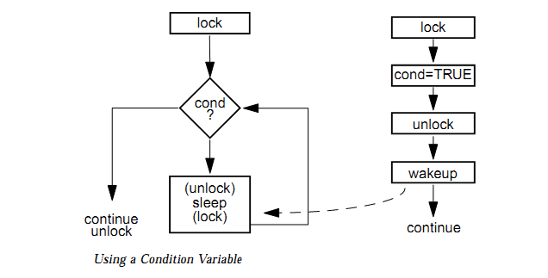
Condition Variables
Reference: http://blog.csdn.net/imyfriend/article/details/7590547

Slide 18
Condition Variables: Data Structure
Wait until a variable meets a particular condition
There is no actual variable in the CV
/* kern/include/synch.h */
struct cv {
char *name;
// add what you need here
};
Notes:
There is little information on condition variables in the textbook

Slide 19
How to implement cv_wait()?
void cv_wait(struct cv *cv, struct lock *lock) {
use assert to check input cv and lock;
turn off interrupts;
release the lock;
/*Question: thread_sleep() using cv or lock?*/
sleep the thread until someone signals cv;
acquire the lock;
turn on interrupts to the previous level;
}
Notes:
cv shouldn’t be NULL
lock shouldn’t be NULL
Wait for cv do not wait for lock
Thread_sleep
Using cv

Slide 20
How to implement cv_signal()?
void cv_signal(struct cv *cv, struct lock *lock) {
use assert to check cv and lock;
turn off interrupts;
/* Question: How to implement the following IF */
if (this thread does not hold lock)
panic("cv_signal error: cv %s at %p, lock %s at
%p.\n", cv->name, cv, lock->name, lock);
/* see also how to wakeup a thread Slide 15 */
wakeup one thread using indicator “cv”;
turn on interrupts to the previous level;
}
Notes:
cv shouldn’t be NULL
lock shouldn’t be NULL

Slide 21
Condition Variables: Sample Usage
/* Declare a cv */
static struct cv *sample_cv;
/* Initialize the cv */
sample_cv = cv_create(”sample cv");
if (sample_cv == NULL) /* Why panic? */
panic(”sample_cv: Out of memory.\n");
/* Destroy the cv in the end */
cv_destroy(sample_cv);
sample_cv = NULL;
cv_wait(sample_cv, sample_lock); /* Wait */
cv_signal(sample_cv, sample_lock); /*Signal*/

Slide 22
Producer/Consumer How to use condition variables in OS/161?
char buffer[SIZE];
int count = 0, head = 0, tail = 0;
static struct lock *mutex;
static struct cv *notEmpty;
static struct cv *notFull;
mutex = lock_create(“mutex for cv”);
if (mutex == NULL)
panic(”mutex: Out of memory.\n");
notEmpty = cv_create(“Buffer not empty”);
notFull = cv_create(“Buffer not full”);
if (notEmpty == NULL || notFull == NULL)
panic(”CV: Out of memory.\n");
Notes:
Which lock_acqure and lock_release are a pair?

Slide 23
Synchronization Cats and Mice Implementation using Locks and Condition Variables
Notes:
50 Minutes: slides 1-10

Slide 24
Condition Variables: Data Structure
Wait until a variable meets a particular condition
There is no actual variable in the CV
/* kern/include/synch.h */
struct cv {
char *name;
// add what you need here
};
Notes:
There is little information on condition variables in the textbook

Slide 25
How to implement cv_signal()?
void cv_signal(struct cv *cv, struct lock *lock) {
use assert to check cv and lock;
turn off interrupts;
/* Question 1: Why panic below? */
/* Question 2: How to implement this IF statement */
if (this thread does not hold lock)
panic("cv_signal error: cv %s at %p, lock %s at
%p.\n", cv->name, cv, lock->name, lock);
/* see also how to wakeup a thread Slide 15 */
wakeup one thread using indicator “cv”;
turn on interrupts to the previous level;
}
Notes:
cv shouldn’t be NULL
lock shouldn’t be NULL

Slide 26
In order to understand the implementation of thread_sleep() and thread_wakeup(), you have to study the thread/thread.c source code file. The global queue of sleepers is declared on lines 28-29 (see below).

Slide 27
The thread_wakeup() function (see line 511) wakes up one or more threads who are sleeping on “sleep address” ADDR. If you only want to wake up a single sleeper, you will have to modify this function by adding a break statement at the end of the if statement. For example,
If (t->t_sleepaddr == addr) {
…
assert(result == 0);
break;
}

Slide 28
Condition Variables: Sample Usage
/* Declare a cv. Question 1: Why no initial value? */
static struct cv *sample_cv;
/* Initialize the cv */
sample_cv = cv_create(”sample cv");
if (sample_cv == NULL) /* Question 2: Why panic? */
panic(”sample_cv: Out of memory.\n");
/* Destroy the cv in the end */
cv_destroy(sample_cv);
sample_cv = NULL;
cv_wait(sample_cv, sample_lock); /* Wait */
cv_signal(sample_cv, sample_lock); /*Signal*/

Slide 29
Producer/Consumer: How to use condition variables in OS/161?
char buffer[SIZE];
int count = 0, head = 0, tail = 0;
static struct lock *mutex;
static struct cv *notEmpty;
static struct cv *notFull;
mutex = lock_create(“mutex for cv”);
if (mutex == NULL)
panic(”mutex: Out of memory.\n");
notEmpty = cv_create(“Buffer not empty”);
notFull = cv_create(“Buffer not full”);
if (notEmpty == NULL || notFull == NULL)
panic(”CV: Out of memory.\n");
Notes:
Which lock_acqure and lock_release are a pair?

Slide 30
Basic Idea: Timesharing Policy
Two cats per turn and two mice per turn
cats_turns = 2;
mice_turns = 2;
Notes:
"static" can be used to limit the scope of global variable to only the file it is declared in.
Describe the basic idea on the whiteboard

Slide 31
Exercise 1. Please initialize the lock and two CVs.
static struct lock *mutex;
/* wait for the cat or mouse turn */
static struct cv *turn_cv;
/* wait here for process done */
static struct cv *done_cv;
/* 1. NOCATMOUSE, 2. CATS 3. MICE */
static volatile int turn_type;
/* Initialize mutex and two condition variables */
mutex = lock_create("catlock mutex");
turn_cv = cv_create("catlock turn cv");
done_cv = cv_create("catlock done cv");
Notes:
"static" can be used to limit the scope of global variable to only the file it is declared in.

Slide 32
Exercise 2. How can cats wait until their turn?
lock(mutex);
cats_wait_count++; /* Initial value = 0 */
if (turn_type == NOCATMOUSE) {
turn_type = CATS;
cats_in_this_turn = 2; /*Two cats per turn*/
}
/* How? Discussions */
/* Wait until it is the cat turn. */
while (___________________________) {
___________________;
}
cats_in_this_turn--; /* one cat in the kitchen */
cats_eat_count++; /* Initial value = 0 */
print “Cat enters the kitchen.";
Notes:
"static" can be used to limit the scope of global variable to only the file it is declared in.

Slide 33
Exercise 3. How to take a dish?
if (dish1_busy == ________) {
dish1_busy = _________;
mydish = 1;
}
else {
dish2_busy = ______;
mydish = 2;
}
print “Cat is eating.”; /* which cat? */
_____________________; /* release the lock */
clocksleep(1); /* enjoys food */
Notes:
"static" can be used to limit the scope of global variable to only the file it is declared in.

Slide 34
Exercise 4. How to release a dish?
lock(mutex);
print “Cat finishes eating at dish”, mydish;
if (mydish == 1) /* release dish 1 */
dish1_busy = _________;
else /* release dish 2 */
dish2_busy = _________;
/*update the number of cats in kitchen*/
cats_eat_count__________;
/*update the number of waiting cats*/
cats_wait_count__________;
Notes:
"static" can be used to limit the scope of global variable to only the file it is declared in.

Slide 35
Exercise 5. How to implement “Switch Turn”. Consider Case 1 where (1) No waiting mouse and (2) There are waiting cats.
if (No waiting mouse && there are waiting cats) {
/* Wake up one waiting cat to enter */
cats_in_this_turn++;
____________________; /* How? */
}

Slide 36
Switch Turn: Case 2. Last Cat and Timeout
/*Last cat and timeout. Then switch to mice.*/
if (Last Cat and Timeout)
/*see next slide for detail*/
change_turn();
printf ("Cat leaves kitchen.";
unlock(mutex);

Slide 37
Exercise 6. How to switch Turn? change_turn();
/*Case 1: there are waiting mice*/
if (there are waiting mice) {
turn_type = MICE;
mice_in_this_turn = 2;
print “It is mice turn now.”;
}
else if (there are waiting cats) {
/*let cats eat */
cats_in_this_turn = 2;
}
else {/*no waiting cats or mice*/
turn_type = NOCATMOUSE;
}
/* Wake up those waiting for turn change*/
_______________________;

Slide 38
Exercise 1. Please complete the following turn-switch algorithm.
/* Case 1: there are waiting mice */
if (there are waiting mice) {
turn_type = ________________;
mice_in_this_turn = ________________;
print “It is mice turn now.”;
}
else if (there are waiting cats) { /*Case 2*/
/*let cats eat */
cats_in_this_turn = ________________;
}
/* Case 3 */
else {/*no waiting cats or mice*/
turn_type = ________________;
}
/* Wake up those waiting for turn change*/
________________________;

Slide 39
How to implement the driver code catmouselock()?
Implement the driver code in catlock.c
(see cs161/src/kern/asst1)
Prototype
int catmouselock(int nargs, char ** args)
This is a parent process that creates and synchronize six (6) cat and two (2) mouse threads
Who creates this parent process?
Notes:
Use cv_wait() to wait
Ideally, the OS creates the parent process (e.g., main())
In this project, we have not yet built a process manager.
See thread_create() in cs161/src/kern/thread/thread.c

Slide 40
Exercise 2. How to implement the driver code catmouselock()? (cont.)
Five Main Steps
Initialization (Exercise 2.1: What items should we initialize?)
Create six cat threads using thread_fork()
Create two mouse threads using thread_fork()
Wait until the cat and mouse threads are done.
Cleanup (Exercise 2.2: How to cleanup?)
(initialize global variables, condition vars and mutex)
(destroy condition vars and mutex)
Notes:
Use cv_wait() to wait

Slide 41
Create Cat and Mouse Thread using thread_fork()
See the implementation of thread_fork() in cs161/src/kern/thread/thread.c
Create a new thread based on an existing one.
The new thread has name NAME, and starts executing in function FUNC. DATA1 and DATA2 are passed to FUNC.
int thread_fork(const char *name,
void *data1, unsigned long data2,
void (*func)(void *, unsigned long),
struct thread **ret)
error = thread_fork("catlock thread", NULL, index, catlock, NULL);
error = thread_fork("mouselock thread", NULL, index, mouselock, NULL);
Notes:
Use two for loops to create multiple threads
Index in thread_fold() is the cat ID or mouse ID passed to catlock() and mouselock()

Slide 42
Exercise 3. Please follow the sample code to create mouse threads using thread_fork()
static void catlock(void * unusedpointer, unsigned long catnumber);
static void mouselock(void * unusedpointer, unsigned long mousenumber)
Input Parameters:
void * unusedpointer: currently unused.
unsigned long catnumber: holds the cat ID
unsigned long mousenumber: holds the mouse ID
/* Sample Code */
error = thread_fork("catlock thread", NULL, index, catlock, NULL);
Notes:
Index in thread_fold() is the cat ID or mouse ID passed to catlock() and mouselock()
static functions: Functions that are visible only to other functions in the same file.

Slide 43
Exercise 4. How to wait until the cat and mouse threads are done?
4.1: What is the condition under which this parent process (i.e., catmouselock()) has to wait for the cat and mouse threads?
Number of cats that finish eating < 6
Number of mice that finish eating < 2
OR
Should we use AND or OR here?
4.2: Can you let the parent process wait using cv_wait()?
Question: Did I miss anything?
lock_acquire(mutex);
while (num_cats_done < 6 || num_mice_done < 2) cv_wait(donecv, mutex);
lock_release(mutex);
Question: Who wakes up the parent?
Notes:
Use cv_wait() to wait
Question: Who wakes up the parent?
After an animal finishes eating N rounds, the animal wakes up the parent.
Ideally, the OS creates the parent process (e.g., main())
In this project, we have not yet built a process manager.
See thread_create() in cs161/src/kern/thread/thread.c

Slide 44
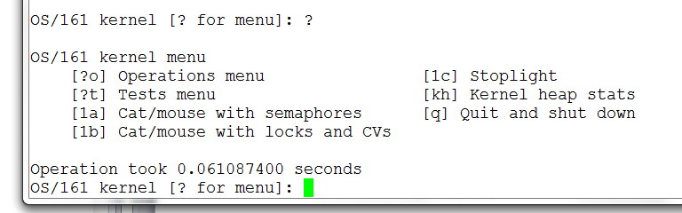
No 1a/1b option in the test menu
Must rebuild kernel for project 3.
%cd ~/cs161/src
%./configure
%cd ~/cs161/src/kern/conf
%./config ASST1
% cd ../compile/ASST1
% make depend
% make

